Slide 1
Design of Software Systems
CS 509
Fall 2022
Prof. George Heineman
WPI
heineman@cs.wpi.edu

Slide 2
Outline
Design
  Interface Design
  Framework Design
  EBC → Cloud Design
  API Design
AWS
  Authentication Issues
  Cloud 9 Experience

Slide 3
Interfaces within every OO program
Implicit
  All public interfaces for all public classes
  Often no rhyme or reason for naming across multiple classes
Explicit
  Marking a method or field as protected
  Enables subclass access to key fields/methods
Explicit Interfaces
  Start with standard defined interfaces
  Eventually design your own to separate functionality within your own programs
  Each interface provides explicit variation point and suggests forward thinking

Slide 4
Binary Array Search
Modified Binary Array Search
  Doesn’t just return TRUE or FALSE
  Returns index location where
  value was found OR a
  negative number X such that
  target could be inserted into
  A[X] to maintain sorted order
When you try to return
more information than is
otherwise specified by
the interface
def binary_array_search(A, target):
lo = 0
hi = len(A) - 1
while lo <= hi:
mid = (lo + hi) // 2
if target < A[mid]:
hi = mid-1
elif target > A[mid]:
lo = mid+1
else:
return mid
return -(lo+1)

Slide 5
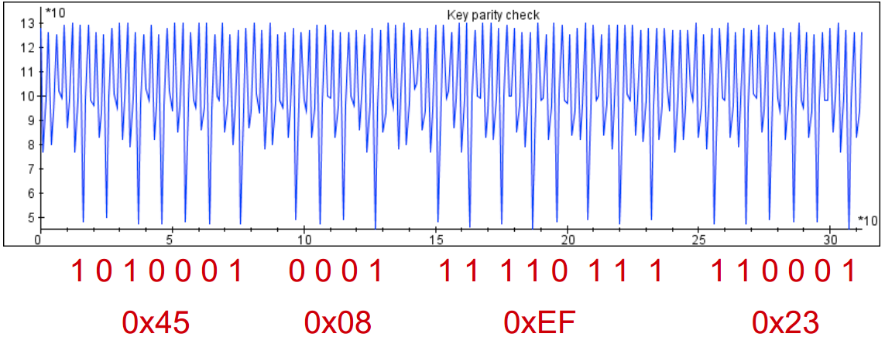
Bad Security Design
Side channel attack
public static boolean checkParity (byte[] key, int offset) {
for (int i = 0; i < DES_KEY_LEN; i++) { // for all key bytes
byte keyByte = key[i + offset];
int count = 0;
while (keyByte != 0) { // loop till no ‘1’ bits left
if ((keyByte & 0x01) != 0) {
count++; // increment for every ‘1’ bit
}
keyByte >>>= 1; // shift right
}
if ((count & 1) == 0) { // not odd
return false; // parity not adjusted
}
}
return true; // all bytes were odd
}

Slide 6
Use Of Exceptions In Design
What happens when software has no answer?
  What is the value of 25/0? And is it different than 25.0/0.0?
  What is the 5th element of an array with 3 elements?
An Exception is the way a program can alert the caller something “unexpected” happened
  Can also be used to alert caller that a “planned-for” abnormal situation has occurred
  Document the proper range of parameters. If caller doesn’t check then a RuntimeException will be thrown
/** Return given shape by index position. rowIndex < size() */
public Shape get(int rowIndex) {
return shapes.get(rowIndex);
}

Slide 7
RuntimeException in Java
Covers a whole range of possible behaviors
  ArrayIndexOutOfBoundsException
  NullPointerException
What if someone tries to decrement value below its minimum?
  “You Shall Not Pass” … Gandalf the Gray
Lots of Tutorials on the Subject [Sun Tutorial]
/** Reduce value up until minimum, throw exception if unable. */
public void decrement () {
if (value == min) {
throw new RuntimeException ("Value cannot be decreased!");
}
value--;
}

Slide 8
Java Exceptions
Checked exception forces programmer to prepare
  Predicable error that might occur in context
static Board loadState(String location) {
ObjectInputStream ois = null;
Board b = new Board();
ois = new ObjectInputStream (new FileInputStream(location));
BoardMemento m = (BoardMemento) ois.readObject();
ois.close();
b.restore(m);
ois.close();
return b;
}

Slide 9
Java Exceptions
Checked exception forces programmer to prepare
  Predicable error that might occur in context
static Board loadState(String location) {
ObjectInputStream ois = null;
Board b = new Board();
try {
ois = new ObjectInputStream (new FileInputStream(location));
BoardMemento m = (BoardMemento) ois.readObject();
ois.close();
b.restore(m);
} catch (Exception e) {
System.err.println("Unable to load state from:" + location);
b = null;
}
if (ois != null) {
try { ois.close(); } catch (IOException ioe) { }
}
return b;
}

Slide 10
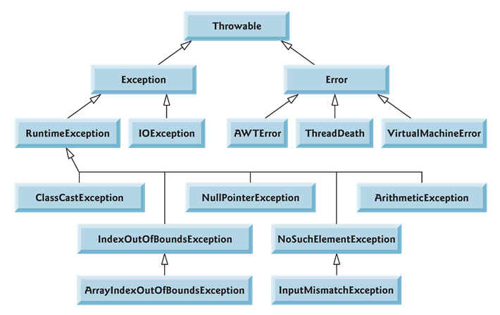
Exception Hierarchy
Checked Exceptions
Unchecked Exceptions
http://cs.loc.edu/~chu/JAVA2/Ch11/java_exception_hierarchy.htm

Slide 11
Use Of Exceptions In Interfaces
Checked Exceptions
  Must be enforced via static code blocks
Unchecked Exceptions
  Dynamic Runtime exceptions
  Discretion to the client who invokes the operation that threw the exception
Checked Exceptions require programmer to take action
  Delegate resolution of problem to “higher authority”
  No blank exception handlers

Slide 12
Exception Handling
Multiple exceptions caught at once
Resource-aware handlers
  input is automatically closed, whether succeed or exception
  Any class that implements AutoCloseable { void close() throws Exception; }
try {
// do something
} catch (ParserConfigurationException | SAXException | IOException e) {
// error condition
}
try (FileInputStream input = new FileInputStream(puzzleFile)) {
return tryParse(input);
} catch (IOException ioe) {
ioe.printStackTrace();
return Optional.empty();
}

Slide 13
Exception Handling Syntax (link)
Try clause
  Sequence of operations, any of which can throw exception
Catch clause(s)
  Sequence of bodies, each one prepared to handle specific exception type
Finally clause
  Ability to add common resolution code that is guaranteed to run at end of block regardless of whether exception was thrown
  Useful for cleanup
Java 1.7 introduced Exception handler called try-with-resources
  Common case

Slide 14
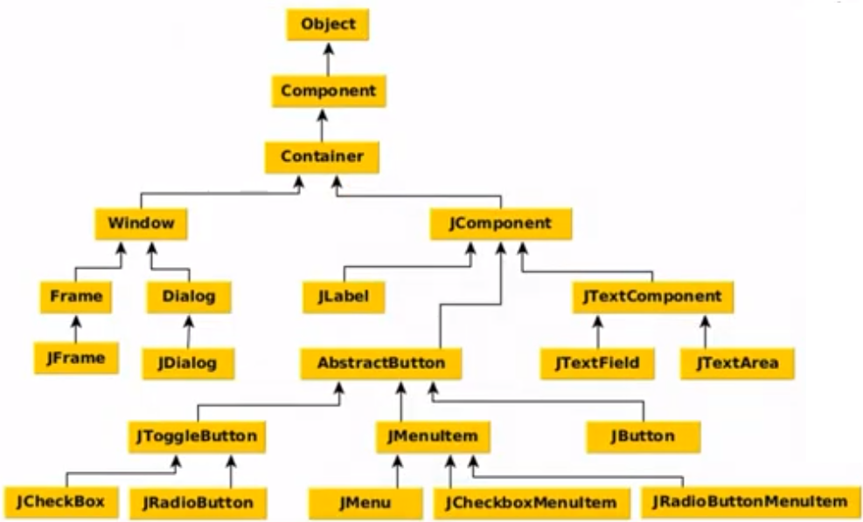
Swing Classes
GUI widget toolkit for Java [link]
  Platform-independent model-view-controller GUI framework
  Light-weight replacement for original AWT windowing toolkit
Consistent API usage
naming schemes because of core superclasses
Event listeners and firing of action events

Slide 15
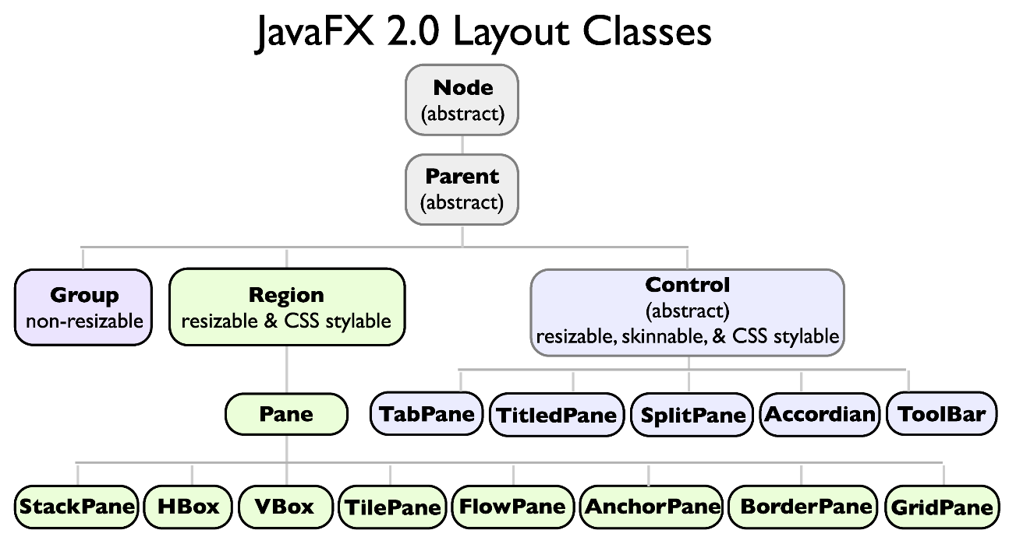
Java FX
Create single framework to create applications for desktop, iOS and Android devices [link]
  Rich Internet Applications
Starting with JDK 11, Oracle removed JavaFX from the JDK
→ Moved to open source libraries

Slide 16
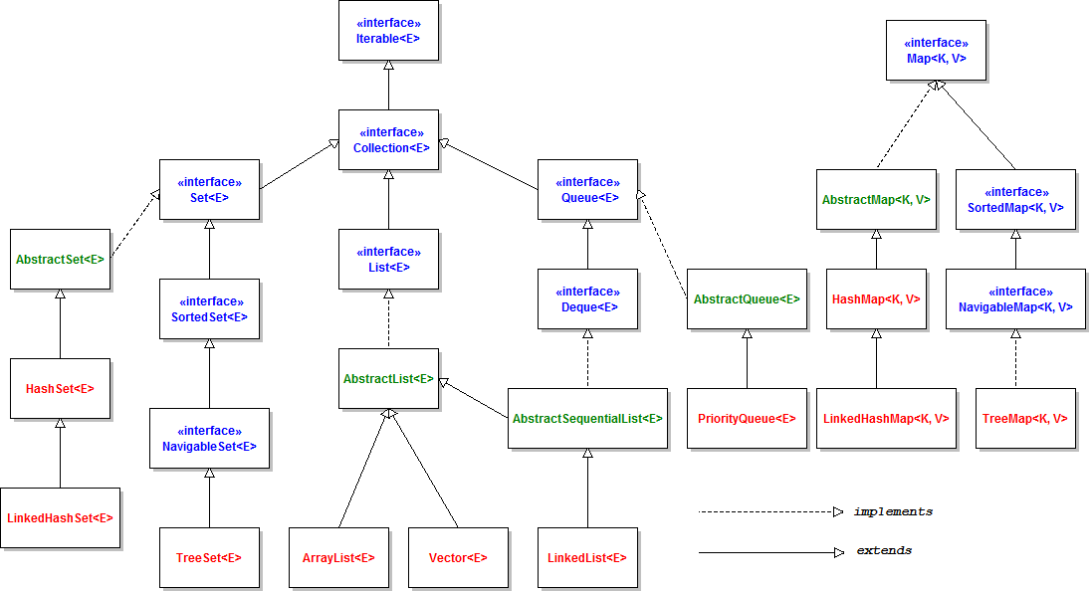
Java Collections Framework
  FAQ

Slide 17
Details
Details reveal
the careful
design of
the framework
Naming schemes
Essential incompatibility
between Collection and Map

Slide 18
Scaling Design to Cloud
Consider design in terms of objects
  Primary app GUI object
  Primary model Element object
Navigation Is Key
Controllers push changes to the boundaries
How to adjust for Cloud Platform?
Boundaries
Entities
Controllers

Slide 19
Vision Moving Forward
Entity objects
  Stored in RDS database tables
  When exist in JavaScript, only as transient objects
  Model offers Façade to database storage
Boundary objects
  Web-browser context so objects “vanish”
  React front end using different “models” for rendering
  Java script for user interaction
  HTML DOM manipulation in response
Controllers
  Lambda Service(s) on cloud
  API Gateway defines them all
  Stateless

Slide 20
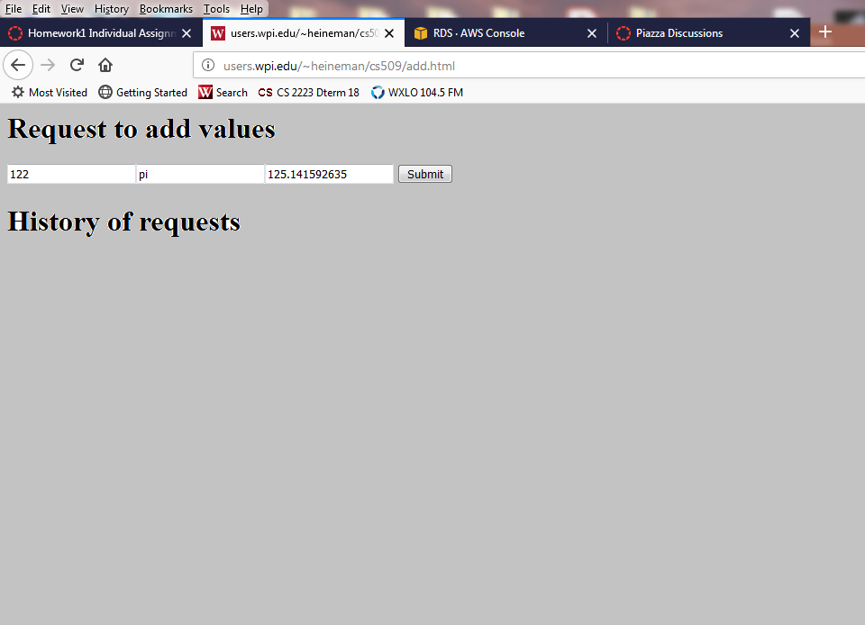
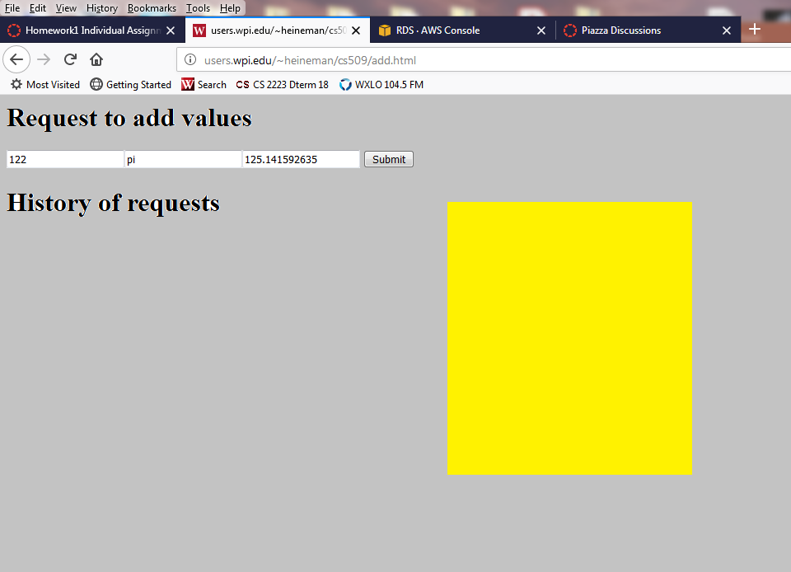
Client ← → Cloud Communication
B
C
E
Browser
Cloud
S3
RDS
start
button
λ
refresh
Unstructured
Data
Structured
Data

Slide 21
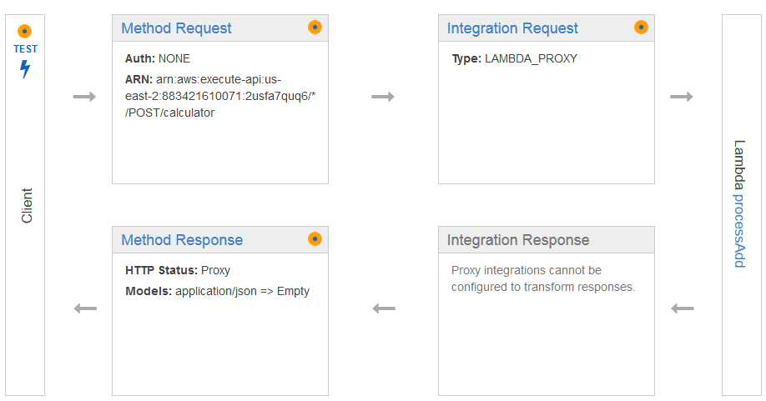
Exception Handling in HTTP
Lambda Functions return JSON fragment
  How does a lambda function report an error?
  Report/consider AddResponse with its own httpCode
  Use Lambda Proxy integration is overly simplistic
Declare 200 and 403/400

Slide 22
REST API
Every request must be self-contained, with all information necessary to process request
Every response must conform to expected model
Consider appropriate HTTP status codes
  200 OK
  400 Bad Request ➔ For initial specification you only need one
  403 Forbidden
  404 Not Found
Note: You do not put 500-series responses into the API

Slide 23
Application Defined by API protocols
Resources
  Try to name each systematically and with cohesion
  Don’t mix upper case and lower case (or CamelCase and a_b_c)
Group where you see fit
  /corporate/…
  /manager/…
  /… for customers
Expected Responses
  200 for normal response
  400 when cannot be satisfied (i.e., try to buy when item has become sold out)

Slide 24
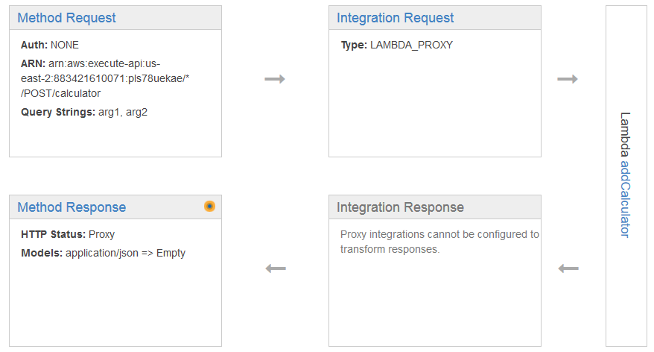
Challenges to Testing With AWS
Where does error reside?
  Bad HTML in S3 bucket loaded initially by client
  Bad Javascript in HTML
  Method Request doesn’t check types of arguments
  Lambda Service has defect
  Lambda Service produces wrong type of data

Slide 25
How to craft GET request with parameters?
Three different possibilities
  GET Path parameters
    http://example.com/url/access/{path}/{another}
  GET Query parameters
    http://example.com/url/access?path=abc&another=xyz
  Turn into a POST
    http://example.com/url/access
    Just send the JSON payload { “path” : “abc”, “another”: “xyz” }

Slide 26
Authentication
AWS Amplify and AWS Cognito
Alternatively, you can provide extra input fields that are used to send query parameters to each API request
  http://example.com/url/access/{path}/{another}?var1=v1&v2=8

